Slide 1
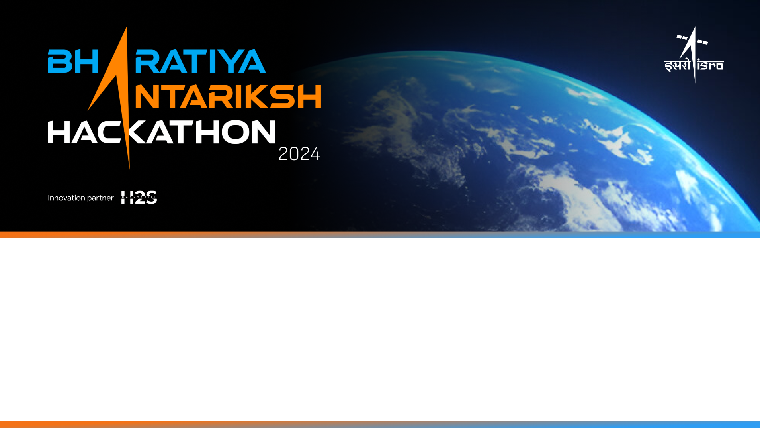
Team Name
Creator’s 1
Name of College : LDRP Gandhinagar

Slide 2
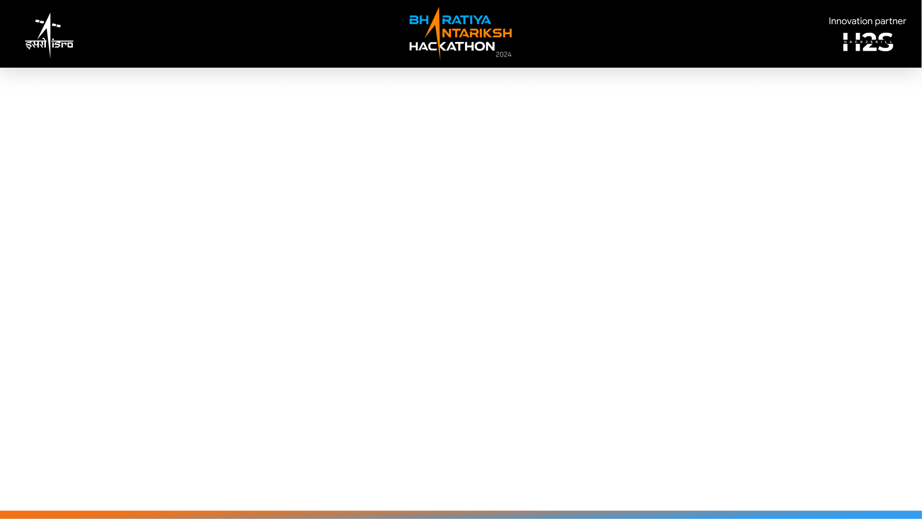
Problem Statement 12:
Context-Aware Geospatial Data Retrieval using LLM/NLP

Slide 3
Introduction to member in my Team:
1. Gajjar Yash:
Studying from LDRP Gandhinagar
Field : IT
Hobby : Space Tech and much more about space
2. Haridas Yadav:
Studying from LDRP Gandhinagar
Field : CS
3. Shah Kirtan:
Studying in 3rd Sem from LDRP Gandhinagar
Field : CS

Slide 4
Tools and Technology Used:
Tools & technology usage :
The Morden technology we used for LLM to get specific the given given data using AI/ML and the predication should also be use to get-in detail and accurate answer from the predication
Also the AI can help to direct detect and generate foreign soil and get blueprint from the given data, then after NLP can get be predicated from that given blueprint data and genrate accurate data from that given architecture
Query Processing and Execution also help to connect direct to database where we store data in any syntax also we store multiple pararmeter from given api where we get predication data and make a log for AI bots
Cloud Platforms and Infrastructure that we used to innovate something new to you and our project also that need some oracle database and a cloud platform

Slide 5
The Technology we used for project:
1. Natural Language Processing (NLP) and Large Language Models (LLMs) :
- Enables computers to understand and interact with human language through text and speech. (LLMs), like GPT-4, use vast amounts of data and complex algorithms to generate and interpret human-like text, enhancing applications such as chatbots and language translation.
2. Geospatial Databases and System :
- manage and analyze spatial data, including geographic locations and features. They store, retrieve, and visualize data such as maps and coordinates for various applications.
3. Query Processing and Execution :
- Query processing and execution involve parsing, optimizing, and running database queries to retrieve or manipulate data. It translates user requests into actions, ensuring efficient, accurate results.
4. Database application :
- A database application is software that interacts with a database to manage, retrieve, and manipulate data. It provides user interfaces and tools for efficient data handling and operations.
5. Data Integration and APIs;
- Data integration combines data from various sources into a unified view, while APIs (Application Programming Interfaces) allow different software systems to communicate and exchange data, facilitating seamless integration and functionality.

Slide 6
6. Machine Learning and Analytics :
- Machine learning uses algorithms to analyze data, identify patterns, and make predictions or decisions. Analytics involves interpreting data to uncover insights and trends, guiding informed decision-making and strategic actions.
7. Cloud Platforms and Infrastructure ;
- Cloud platforms provide scalable, on-demand computing resources and services over the internet, while infrastructure refers to the underlying hardware and software that supports these services, enabling flexible, cost-efficient IT solutions.

Slide 7
Detailed solution and Approach :
Context-aware geospatial data retrieval using Large Language Models (LLMs) and Natural Language Processing (NLP) is a fascinating and rapidly evolving area that merges spatial data with advanced language understanding. Here’s an overview of how this might work:
1. Understanding Geospatial Data
- Geospatial data refers to information about geographic locations and features on the Earth's surface. It includes data such as coordinates, boundaries, elevation, land use, and more. This data can be stored in various formats such as GIS (Geographic Information Systems) databases, shapefiles, and raster data.
2. Context-Aware Retrieval :
- Context-aware retrieval means that the system understands and interprets the context of the user's query to provide relevant geospatial information. This can include:
3. Integration of LLMs and NLP:
- LLMs like GPT-4 can be leveraged to enhance geospatial data retrieval by using their language understanding capabilities:
- Contextual Understanding: By analyzing the context in which a query is made, LLMs can provide more accurate results. For example, if a user frequently searches for restaurants, the system can prioritize restaurant-related results.
- Data Enrichment: LLMs can help in enriching geospatial data by generating descriptions, summaries, and insights based on the available data.

Slide 8
4. System Architecture :
- A typical system for context-aware geospatial data retrieval might involve:
1. Data Storage: A geospatial database or GIS system to store and manage geospatial data.
2.NLP Processing: A module using LLMs to process and interpret natural language queries.
3. Context Analysis: A system to analyze the user's context, including location, preferences, and history.
4. Query Execution: A component that translates interpreted queries into spatial queries that can be executed
against the geospatial database.
5. Results Aggregation: Aggregating results and possibly providing additional insights or recommendations.
5. Applications :
1. Navigation**: Enhancing GPS-based navigation systems by understanding and predicting user needs and preferences.
2. Urban Planning**: Assisting city planners by retrieving and analyzing relevant spatial data based on specific queries or scenarios.
3. Emergency Services**: Helping in emergency response by quickly retrieving relevant spatial data based on real-time queries.
6. Challenges :
- Data Quality: Ensuring the accuracy and completeness of geospatial data.
- Complex Queries: Handling complex and ambiguous queries effectively.
- Integration: Seamlessly integrating LLMs with geospatial databases and ensuring efficient performance.

Slide 9
Opportunity & better Ideas :
Q1. How different is it from any of the other existing ideas?
Ans : To assess how a solution's features differ from existing ideas, consider the following points:
1. Innovation: Does the solution introduce novel functionalities or improvements that aren't available
in current solutions?
2. Integration: How does it integrate with existing systems compared to other solutions? Is it more
seamless or flexible?
3. Usability: Are there unique aspects of the user experience that set it apart, such as a more intuitive
interface or advanced customization options?
4. Performance: Does it offer superior performance, scalability, or efficiency compared to existing solutions?
5. Cost: Is it more cost-effective or offer better value compared to similar options?
6. Support and Services: How does its customer support or additional services compare in terms of quality
and accessibility?
7. Security and Compliance: Are its security measures or compliance features more robust than those of competitors?

Slide 10
Q2. How will it be able to solve the problem?
Ans :
Our "Context-Aware Geospatial Data Retrieval using LLM/NLP" solution is meticulously designed to tackle the unique challenges faced by ISRO in managing and utilizing geospatial data. Here's how our innovative approach provides effective solutions:
1. Efficient Data Management:
- Challenge: ISRO handles vast amounts of geospatial data from multiple sources, making it challenging to manage and retrieve relevant information quickly.
- Solution: Our system uses advanced LLM and NLP to interpret complex queries and retrieve the most relevant data
efficiently. It understands the context and intent behind each query, ensuring precise and timely data retrieval.
2. Enhanced Decision-Making:
- Challenge: Making informed decisions requires accessing accurate and contextually relevant geospatial data, which can be time-consuming and error-prone with traditional methods.
- Solution: By leveraging context-aware capabilities, our solution filters and processes geospatial data based on specific mission requirements. This ensures that decision-makers have access to actionable insights, improving the quality and speed of their decisions.
3. Seamless Integration with Existing Systems:
- Challenge: Integrating new data retrieval systems with existing ISRO infrastructure can be complex and disruptive.

Slide 11
4. User-Friendly Interface:
- Challenge: Geospatial data tools often require specialized knowledge, limiting accessibility to trained personnel.
- Solution: Our natural language interface enables ISRO’s diverse team to interact with the system using simple, everyday
language. This democratizes access to geospatial data, empowering more team members to leverage these insights
without needing specialized training.
5. Multilingual Support:
- Challenge: ISRO’s operations involve collaboration among teams speaking different languages, which can create
communication barriers.
- Solution: Our solution supports multiple Indian languages, ensuring that all team members can interact with the system in
their preferred language. This fosters inclusivity and enhances collaboration across the organization.
6. Scalability and Future-Readiness:
- Challenge: As ISRO’s satellite fleet and data volumes grow, traditional data management systems may struggle to scale.
- Solution: Our system is built to scale, accommodating increasing data volumes and expanding functionalities as ISRO’s
needs evolve. It is future-ready, ensuring long-term viability and adaptability to new technological advancements.
7. Predictive Insights for Mission Planning:
- Challenge: Anticipating future scenarios and planning missions effectively requires advanced analytical capabilities.
- Solution: By integrating machine learning models, our solution provides predictive insights based on historical geospatial
data. This aids in proactive mission planning and risk assessment, enhancing the strategic capabilities of ISRO.

Slide 12
8. Robust Security and Compliance:
- Challenge: Ensuring the security of sensitive geospatial data and complying with regulatory requirements are paramount.
- Solution: Our solution employs state-of-the-art security measures, including encryption and access controls, to protect data
integrity and confidentiality. It also adheres to national and international regulations, ensuring ISRO’s operations remain
compliant and ethically sound.
Conclusion Our Context
-Aware Geospatial Data Retrieval system, powered by LLM/NLP, offers ISRO a cutting-edge solution to manage, retrieve, and utilize geospatial data more effectively. By addressing the specific challenges faced by ISRO, our solution enhances decision-making, fosters collaboration, and ensures them
- Organization remains at the forefront of space research and exploration. This innovation not only meets ISRO's current needs but also positions it for future success, driving advancements that benefit India and the world.

Slide 13
Q3. USP of the proposed solution?
Ans :
Unique Selling Proposition (USP) for Context-Aware Geospatial Data Retrieval using LLM/NLP
Title: Revolutionizing Geospatial Data Retrieval with Context-Aware LLM/NLP for ISRO's Advanced Applications
Introduction: As India’s premier space research organization, ISRO continually pushes the boundaries of science and technology
to deliver groundbreaking solutions for national and global needs. Our innovative Context-Aware Geospatial Data
Retrieval system, powered by advanced Large Language Models (LLM) and Natural Language Processing (NLP), offers
a transformative approach to accessing and utilizing geospatial data. Here’s why this solution is uniquely suited to
enhance ISRO’s mission and operations.
1. Intelligent Context Understanding:
- Enhanced Decision-Making: Our system leverages LLM and NLP to comprehend the context behind each query, ensuring that the
retrieved data is not only accurate but also highly relevant. For instance, in disaster management scenarios, the system can prioritize
data related to immediate threats and available resources.
- Adaptive to Dynamic Scenarios: The system continuously learns and adapts to new contexts, making it ideal for the rapidly changing
environments ISRO operates in, such as real-time satellite monitoring and mission planning.
2. Seamless Integration with ISRO’s Existing Infrastructure:
- Interoperability: Designed to integrate seamlessly with ISRO’s existing geospatial databases and tools, our solution enhances current
t capabilities without requiring a complete overhaul. This ensures a smooth transition and immediate usability.
- Scalable and Future-Proof: Our system is built to scale, accommodating the growing volume of data from ISRO’s expanding satellite
fleet and other sources, while staying aligned with future technological advancements.

Slide 14
3. Advanced Natural Language Interface:
- User-Friendly Access: ISRO’s scientists, engineers, and decision-makers can interact with the system using natural language,
eliminating the need for specialized training or complex query languages. This democratizes access to geospatial data across the
organization.
- Multilingual Capabilities: Supporting multiple Indian languages, the system ensures inclusivity and wider accessibility for ISRO’s diverse
team, fostering better collaboration and knowledge sharing.
4. Superior Data Precision and Relevance:
- Context-Driven Precision: By understanding the specific requirements and context of each query, our system delivers data that is not
only precise but also contextually relevant. This reduces information overload and allows ISRO to focus on actionable insights. -
Customizable Filters and Parameters: Users can set custom filters and parameters based on mission
- Specific needs, ensuring that the data retrieved aligns perfectly with the operational goals.
5. Enhanced Analytical Capabilities:
- Predictive Insights: Leveraging advanced machine learning algorithms, our system can provide predictive insights based on historical
geospatial data, aiding in mission planning and risk assessment.
- Visual and Interactive Data Representation: The system offers intuitive visualization tools, enabling ISRO’s teams to interact with data
through maps, graphs, and other visual formats, enhancing understanding and decision-making.
6. Robust Security and Compliance:
- Data Security: Recognizing the critical importance of data security for ISRO, our system employs state-of-the-art encryption and
access control mechanisms to protect sensitive information. - Regulatory Compliance: Our solution is designed to comply with
national and international geospatial data regulations, ensuring that ISRO’s operations remain legally compliant and ethically sound.
Conclusion:
Our Context-Aware Geospatial Data Retrieval system represents a leap forward in how geospatial data can be accessed, analyzed, and utilized. By combining the power of LLM and NLP with a deep understanding of ISRO’s unique needs and challenges,

Slide 15
Proposed architecture/user diagram
Raw Data that can store the condition statement from given live whether and predication
Satellite
Data
with predication from AI/Ml
LDR
Sensor
API
LLM
Model
User Display
&
Input
Web Socket
Web processor
+
front hand
Backhand that handle all the data from servers
NLP Engine

Slide 16
List of features offered by the solution :
Natural Language Query Understanding:
- Intent Recognition: Accurately identifies what the user is trying to find or accomplish based on their natural language input.
- Entity Extraction: Detects and extracts relevant entities from user queries, such as locations, landmarks, or specific features.
- Contextual Interpretation: Understands and incorporates context from the query to refine the meaning and intent.
Context-Aware Enhancements;
- Location Awareness: Utilizes the user’s current location or specified location to provide relevant geospatial data.
- Temporal Context: Takes into account time-related factors, such as historical data, current trends, or future projections.
- Personalization: Adapts results based on user preferences, previous interactions, and behavioral patterns.
A list of features offered by a solution typically includes its key functionalities, benefits, and capabilities. For example:
- User-friendly Interface: Easy navigation and accessibility.
- Data Security: Encryption and secure access controls.
- Scalability: Ability to handle growth and increased demand.
- Integration: Compatibility with other systems and applications.
- Customization: Options for tailoring to specific needs.
- Real-time Analytics: Immediate insights and data processing.
- Automation: Streamlined and automated processes.
- Reporting: Comprehensive and customizable reportin assistance.
- Support: Access to customer service and technical This list can vary based on the specific solution or product in question.

Slide 17
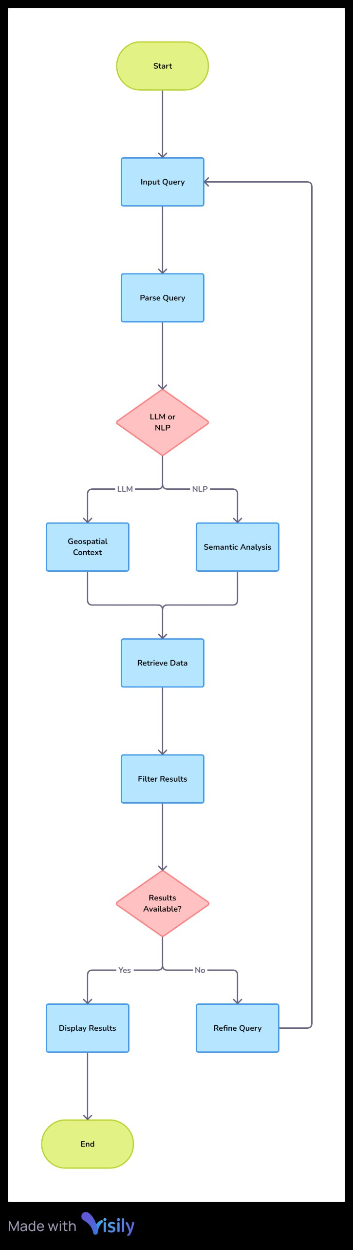
Process flow diagram or Use-case diagram :
This Picture shows the use Case diagram where:
we understand the concept of this program
Easily understands by human mind
As per diagram we saw that there are flowchart where and how the code and user flow is going when he/she using the website and easily be trackable if any error came
Also manages the database where and how data are store in Lama model or any other LLM model

Slide 18
Solution Brief (Final statement):
Overview:
This solution integrates Large Language Models (LLMs) and Natural Language Processing (NLP) to enhance the retrieval of geospatial data by interpreting and acting on user queries within their contextual framework. It aims to bridge the gap between complex geospatial datasets and user-friendly interactions.
Key Components:
1. Natural Language Processing (NLP):
- Query Understanding: NLP interprets user queries, extracting key elements such as location, spatial relationships, and specific requirements.
- Contextual Interpretation: LLMs assess the context of queries to grasp nuanced user intents, such as temporal factors or
specific geographic references.
2. Contextual Analysis:
- Context Extraction: Analyzes contextual information from user inputs to refine and specify the geospatial data needed.
- Relevance Scoring: Evaluates the relevance of geospatial data based on contextual factors, ensuring more accurate and pertinent results. quality and relevance of results.

Slide 19
3. Geospatial Data Retrieval:
- Data Querying: Translates context-aware queries into precise requests for geospatial databases or APIs.
- Dynamic Filtering: Retrieves and filters data based on contextual insights to enhance the
4. User Interaction:
- Intuitive Responses: Presents results in a user-friendly format, allowing for easy exploration and interaction with geospatial data.
- Adaptive Feedback: Adjusts data retrieval and presentation based on user feedback and further queries.
Benefits:
- Improved Accuracy: Enhanced retrieval precision by understanding and incorporating contextual details.
- Enhanced Usability: Simplifies complex data interactions through natural language, making geospatial data more accessible.
- Efficient Information Access: Streamlines the process of obtaining relevant geospatial information, reducing time and effort.
Applications:
- Urban Planning: Facilitates detailed and context-aware analysis for city planning and development.
- Disaster Management: Provides precise data for emergency response based on current situational context.
- Travel and Navigation: Enhances travel planning and route optimization with contextually relevant geospatial insights.

Slide 20
